Slide 1


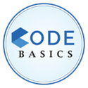





ATLIQ
MART
AtliQ Mart
Unlocking Sales Potential : Analyze Promotions and Provide Tangible Insights to Sales Director
Code Basics Resume Project Challenge #9
Harshit Arora
Presenter

Slide 2

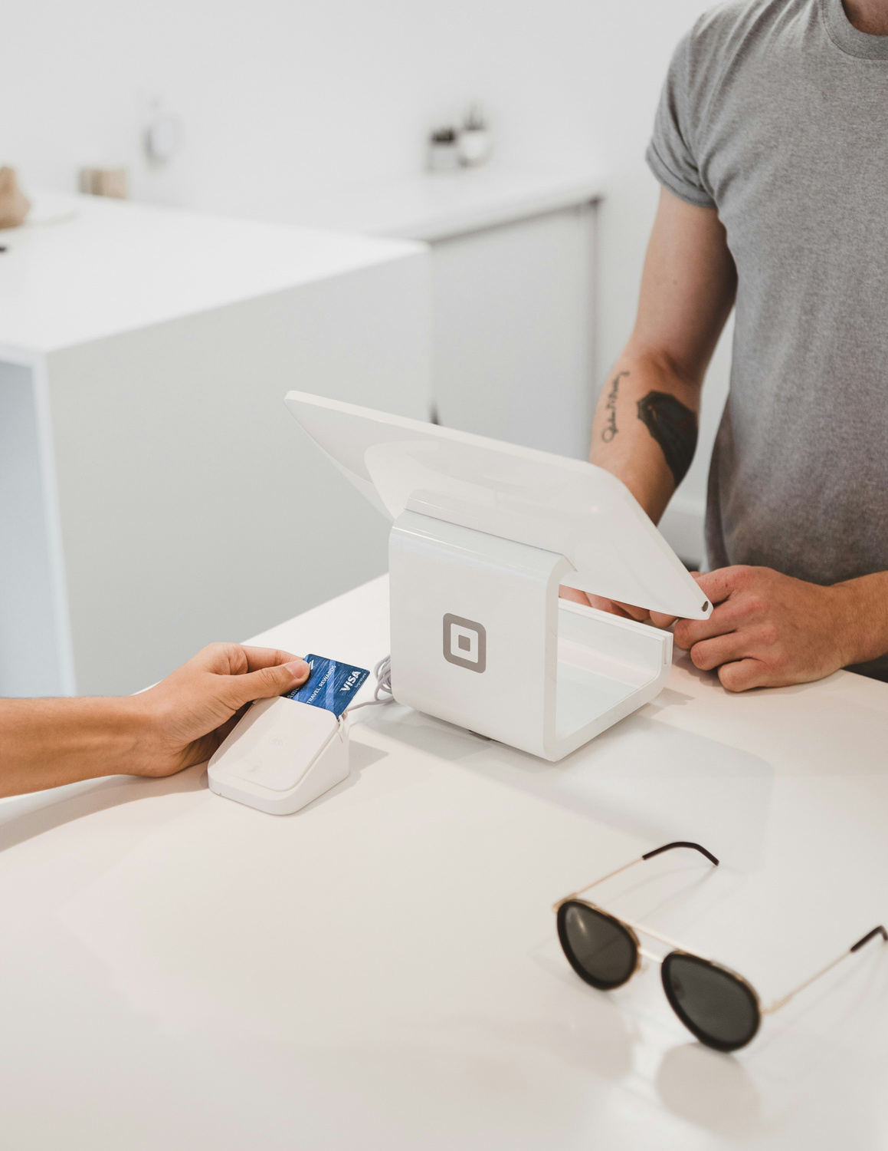
ATLIQ
MART
AtliQ Mart :
Your Trusted Retail Partner
AtliQ Mart is a retail giant with over 50 supermarkets in the southern region of India. All their 50 stores ran a massive promotion during the Diwali 2023 and Sankranti 2024 on their AtliQ branded products.

Slide 3

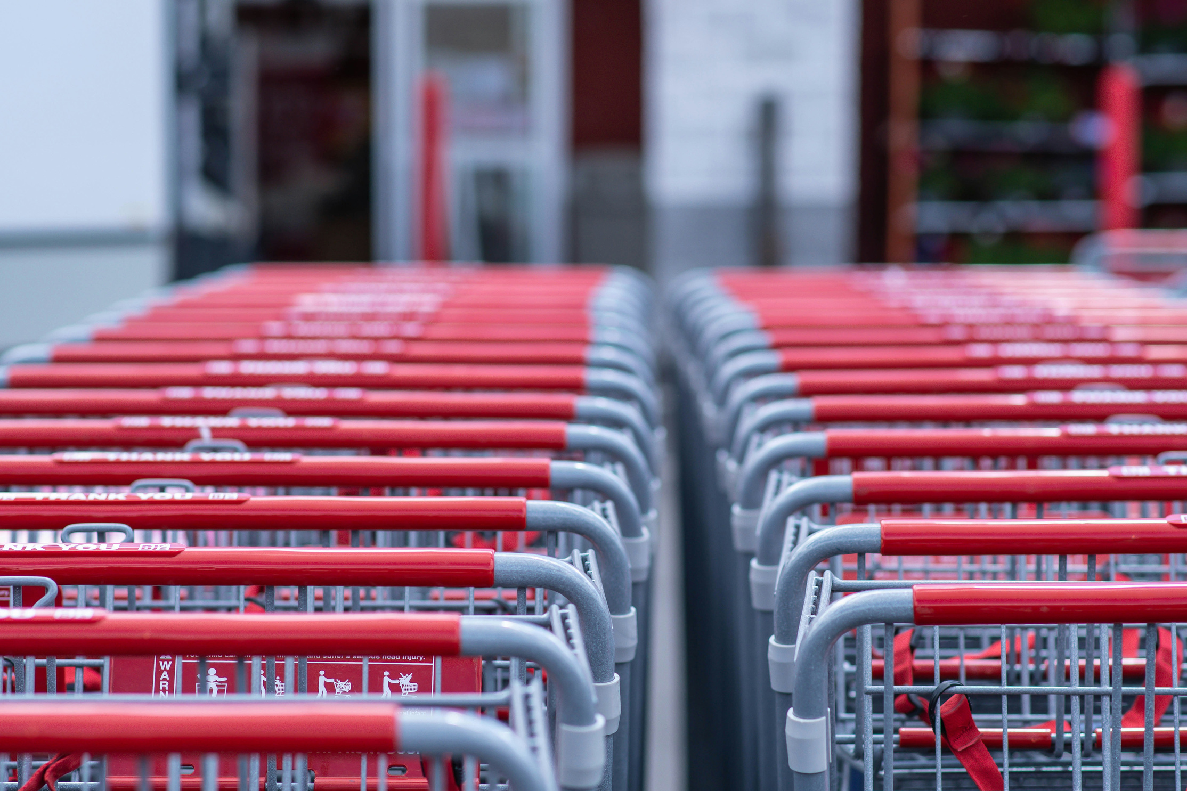

PROBLEM STATEMENT
The sales director wants to understand which promotions did well and which did not so that they can make informed decisions for their next promotional period.

Slide 4

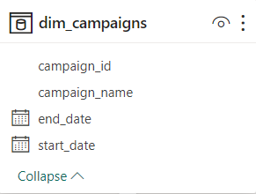

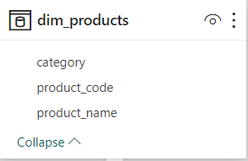
DATASET
01
DIM_CAMPAIGNS
- campaign_id: Unique identifier for each promotional campaign.
- campaign_name: Descriptive name of the campaign (e.g., Diwali, Sankranti).
- start_date: The date on which the campaign begins, formatted as DD-MM-YYYY.
- end_date: The date on which the campaign ends, formatted as DD-MM-YYYY.
02
DIM_PRODUCT
- product_code: Unique code assigned to each product for identification.
- product_name: The full name of the product, including brand and specifics (e.g., quantity, size).
- category: The classification of the product into broader categories such as Grocery & Staples, Home Care, Personal Care, Home Appliances, etc.

Slide 5
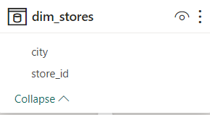

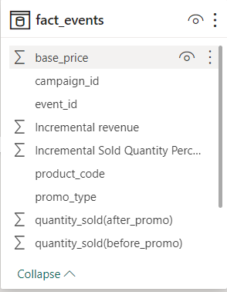


DATASET
03
DIM_STORES
- store_id: Unique code identifying each store location.
- city: The city where the store is located, indicating the geographical market.
04
FACT_EVENTS
-event_id: Unique identifier for each sales event.
-store_id: Refers to the store where the event took place, linked to the dim_stores table.
-campaign_id: Indicates the campaign under which the event was recorded, linked to the dim_campaigns table.
-product_code: The code of the product involved in the sales event, linked to the dim_products table.
-base_price: The standard price of the product before any promotional discount.
-promo_type: The type of promotion applied (e.g., percentage discount, BOGOF, cashback.
-quantity_sold(before_promo): The number of units sold in the week immediately preceding the start of the campaign, serving as a baseline for comparison with promotional sales.
-quantity_sold(after_promo): The quantity of the product sold after the promotion was applied.

Slide 6


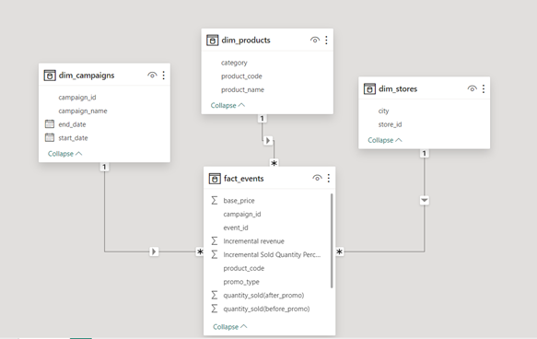
MODEL VIEW

Slide 7
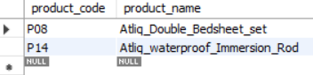
BUSINESS REQUESTS
01
Provide a list of products with a base price greater than 500 and that are featured in promo type of 'BOGOF' (Buy One Get One Free). This information will help us identify high-value products that are currently being heavily discounted, which can be useful for evaluating our pricing and promotion strategies.
SELECT product_code, product_name
FROM dim_products
WHERE product_code IN (
SELECT product_code
FROM fact_events
WHERE base_price >= 500 AND promo_type = 'BOGOF');

Slide 8
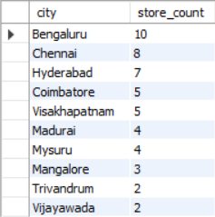
02
Generate a report that provides an overview of the number of stores in each city. The results will be sorted in descending order of store counts, allowing us to identify the cities with the highest store presence.The report includes two essential fields: city and store count, which will assist in optimizing our retail operations.
select city,count(store_id) as store_count
from dim_stores group by city order by store_count desc;
# Created The View for promo Price
create view promo_price as
select *,
case
when promo_type="50% OFF" then base_price*0.5
when promo_type="25% OFF" then base_price*(1-0.25)
when promo_type="33% OFF" then base_price*(1-0.33)
when promo_type="BOGOF" then base_price*0.5
when promo_type="500 Cashback" then base_price-500
end as promo_price
from fact_events;

Slide 9
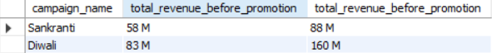
03
Generate a report that displays each campaign along with the total revenue generated before and after the campaign? The report includes three key fields: campaign name, total revenue(before_promotion), total revenue(after promotion). This report should help in evaluating the financial impact of our promotional campaigns. (Display the values in millions)
select campaign_name,
concat(round(sum(base_price*`quantity_sold(before_promo)`)/1000000)," M") as total_revenue_before_promotion, concat(round(Sum(promo_price*`quantity_sold(after_promo)`)/1000000)," M") as total_revenue_before_promotion
from promo_price
join dim_campaigns
using (campaign_id)
group by campaign_name;

Slide 10
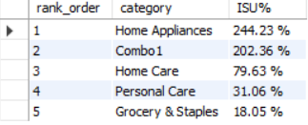
04
Produce a report that calculates the Incremental Sold Quantity (ISU%) for each category during the Diwali campaign. Additionally, provide rankings for the categories based on their ISU%. The report will include three key fields: category, isu%, and rank order. This information will assist in assessing the category-wise success and impact of the Diwali campaign on incremental sales.
select
rank() over( order by round(((sum(`quantity_sold(after_promo)`)-sum(`quantity_sold(before_promo)`))/
sum(`quantity_sold(before_promo)`))*100) desc) as rank_order, category,
concat(round(((sum(`quantity_sold(after_promo)`)-sum(`quantity_sold(before_promo)`))/
sum(`quantity_sold(before_promo)`))*100, 2), " %") as "ISU%“
from fact_events join dim_products using (product_code)
join dim_campaigns using (campaign_id) where campaign_name = "Diwali“ group by category;

Slide 11
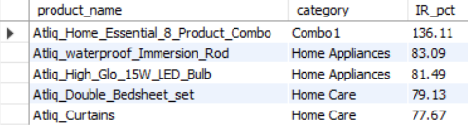
05
Create a report featu ring the Top 5 products, ranked by Incremental Revenue Percentage (IR%), across all campaigns. The report will provide essential information including product name, category, and ir%. This analysis helps identify the most successful products in terms of incremental revenue across our campaigns, assisting in product optimization.
select product_name, category,
round(((sum(promo_price*`quantity_sold(after_promo)`)-sum(base_price*`quantity_sold(before_promo)`))/ sum(base_price*`quantity_sold(before_promo)`))*100, 2) as IR_pct
from promo_price
join dim_products
using (product_code)
group by product_name, category
order by IR_pct desc
limit 5;

Slide 12
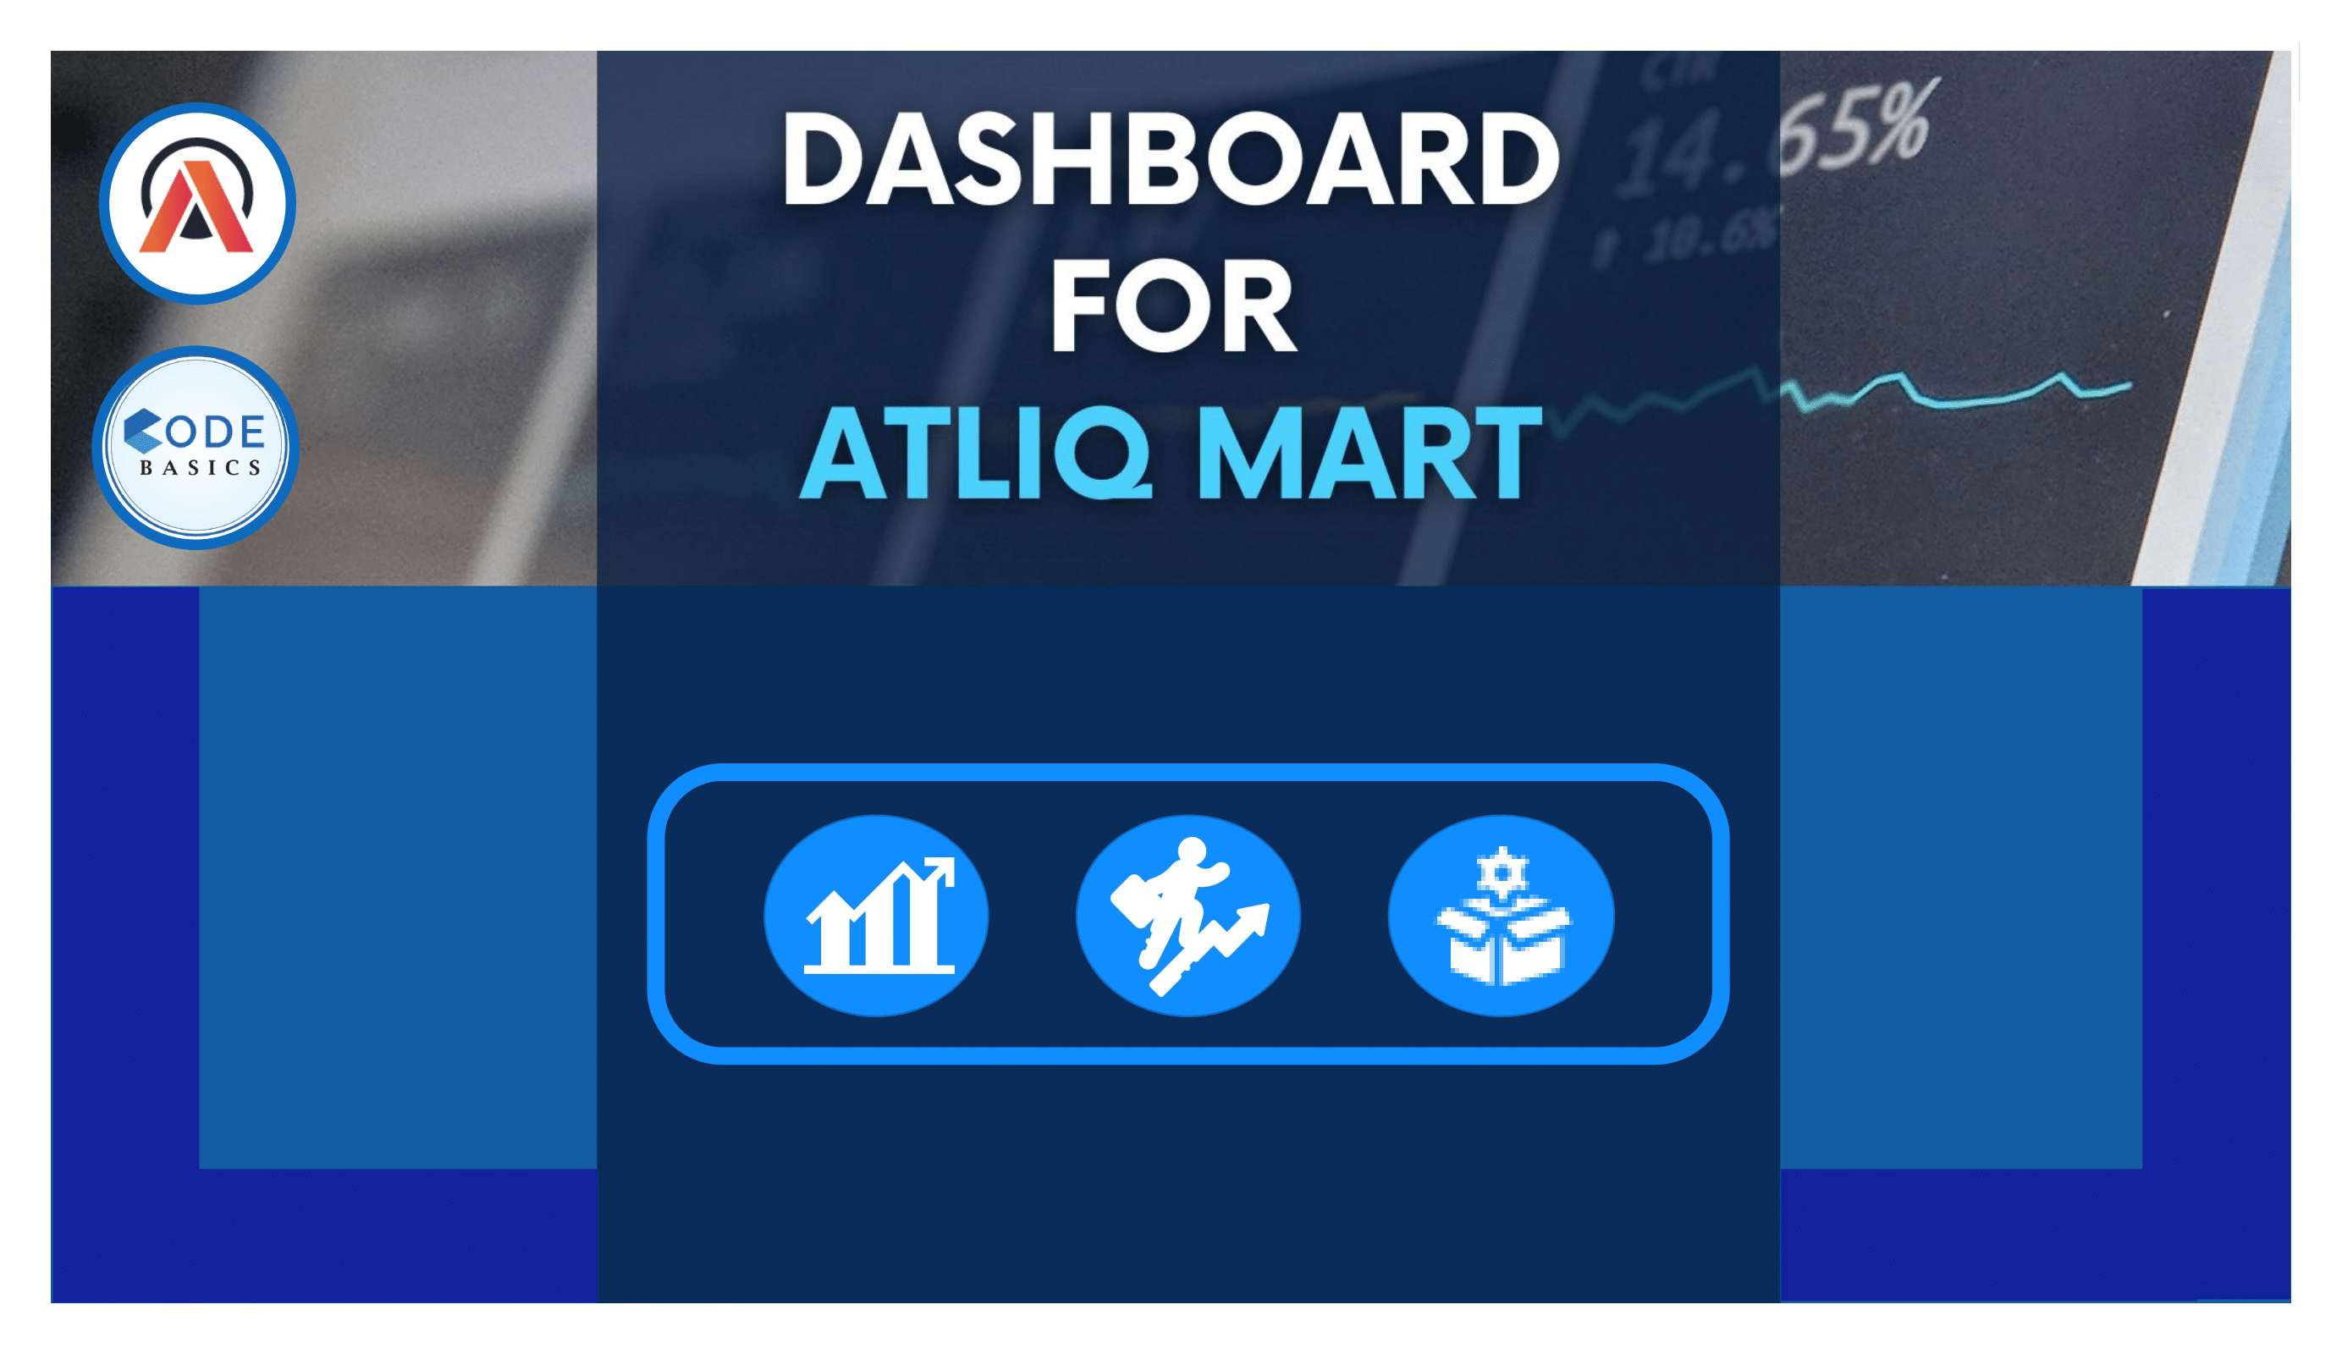

Slide 13
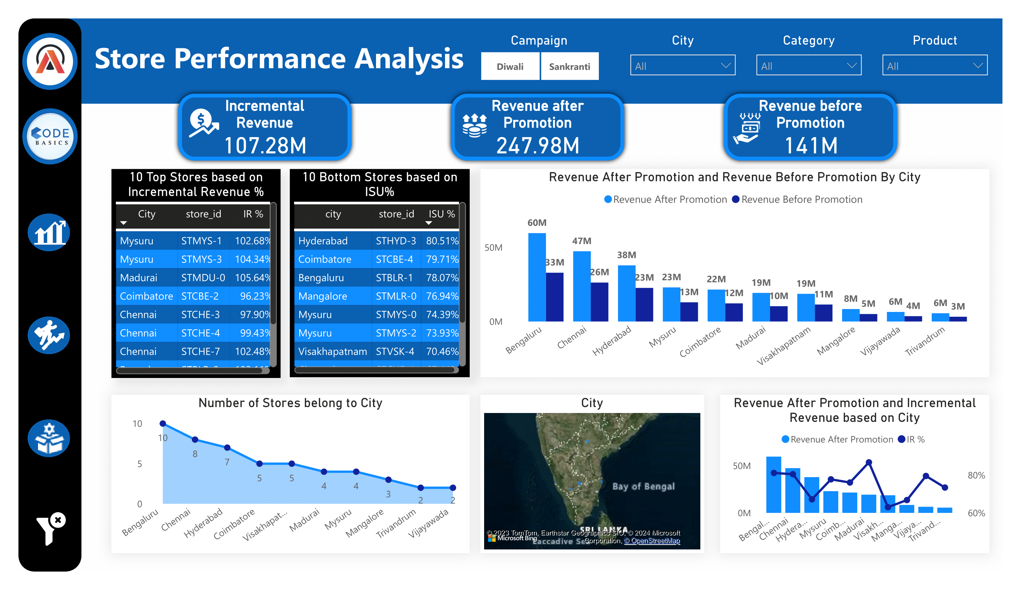

Slide 14
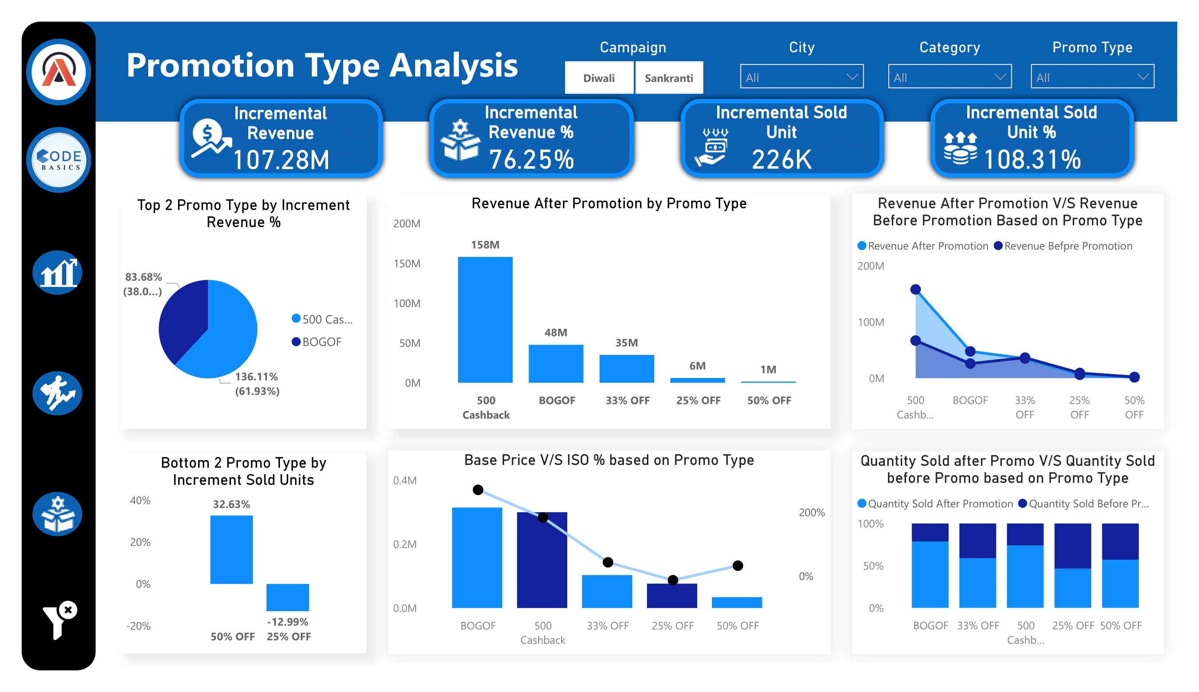

Slide 15
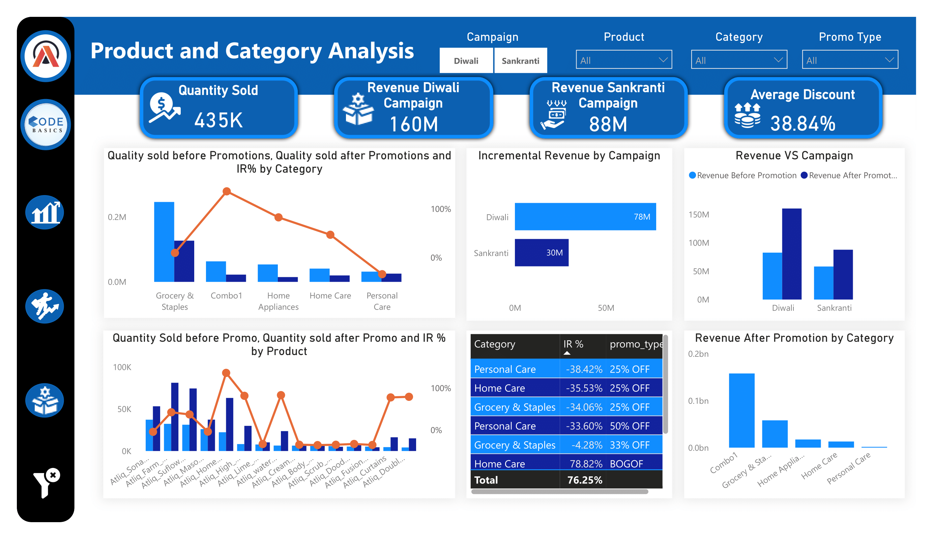

Slide 16
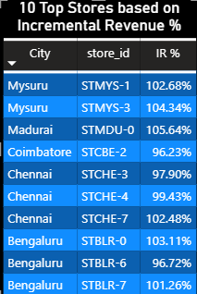


INSIGHTS
STORE PERFORMANCE ANALYSIS
WHICH ARE THE TOP 10 STORES IN TERMS OF INCREMENTAL REVENUE (IR) % GENERATED FROM THE PROMOTIONS?
-STMYS-1 ranks highest in terms of Incremental Revenue (IR) % generated from the promotions.
-Ranked second highest in Incremental Revenue (IR) % generated from promotions, STMYS-3 demonstrates significant contribution to overall revenue growth
-STMDU-0 ranks third in terms of Incremental Revenue (IR) % generated from promotions

Slide 17


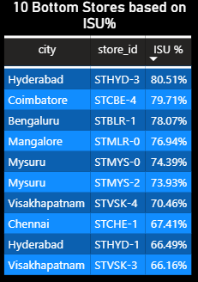
WHICH ARE THE BOTTOM 10 STORES WHEN IT COMES TO INCREMENTAL SOLD UNITS (ISU) % DURING THE PROMOTIONAL PERIOD?
-STHYD-3 ranks at the bottom for Incremental Sold Units (ISU) % during the promotional period
-During the promotional period, STCBE-4 ranks second from the bottom in terms of Incremental Sold Units (ISU) %.
-STBLR-1 ranks third from the bottom in terms of Incremental Sold Units (ISU) % during the promotional period.

Slide 18

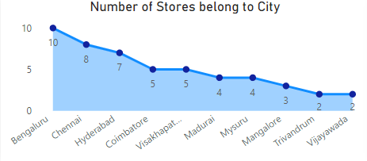
PROVIDE DETAILS ON THE DISTRIBUTION OF STORES ACROSS DIFFERENT CITIES?
-BANGALORE (10 STORES):
BANGALORE, BEING A MAJOR METROPOLITAN CITY AND IT HUB, HAS THE HIGHEST NUMBER OF ATLIQ MART STORES. THIS IS INDICATIVE OF THE CITY'S LARGE POPULATION AND ROBUST ECONOMIC ACTIVITY, MAKING IT A PRIME LOCATION FOR RETAIL EXPANSION.
-CHENNAI (8 STORES):
CHENNAI, THE CAPITAL CITY OF TAMIL NADU, FOLLOWS CLOSELY WITH 8 STORES. AS ONE OF THE LARGEST CULTURAL, ECONOMIC, AND EDUCATIONAL CENTERS IN SOUTH INDIA, CHENNAI ATTRACTS SIGNIFICANT RETAIL INVESTMENT.
-HYDERABAD (7 STORES):
HYDERABAD, KNOWN FOR ITS THRIVING IT INDUSTRY AND HISTORICAL SIGNIFICANCE, BOASTS 7 ATLIQ MART STORES. THE CITY'S GROWING POPULATION AND STRONG CONSUMER DEMAND CONTRIBUTE TO ITS SUBSTANTIAL RETAIL PRESENCE.
-COIMBATORE (5 STORES):
COIMBATORE, OFTEN REFERRED TO AS THE "MANCHESTER OF SOUTH INDIA" DUE TO ITS FLOURISHING TEXTILE INDUSTRY, HOSTS 5 ATLIQ MART STORES. THE CITY'S INDUSTRIAL BASE AND PROSPEROUS BUSINESS ENVIRONMENT MAKE IT AN ATTRACTIVE RETAIL MARKET.
-VISHAKHAPATNAM (5 STORES):
IT HAS 5 ATLIQ MART STORES. ITS STRATEGIC LOCATION, COUPLED WITH INCREASING URBANIZATION AND INFRASTRUCTURE DEVELOPMENT, SUPPORTS A THRIVING RETAIL SECTOR.

Slide 19
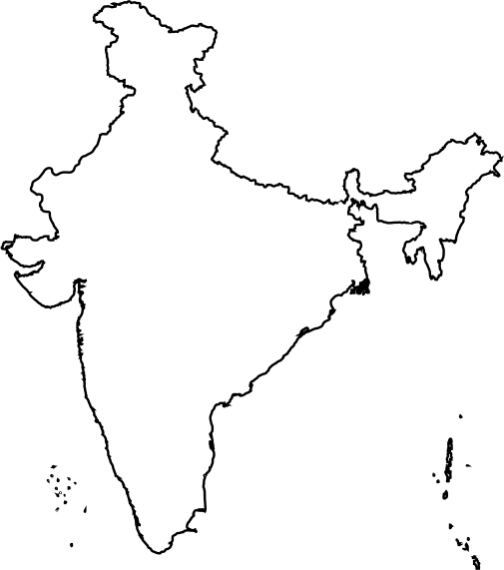

-Madurai (4 stores):
Madurai, known for its rich cultural heritage and historical significance, accommodates 4 AtliQ Mart stores.
-Mysuru (4 stores):
Mysuru, renowned for its royal heritage and tourist attractions, features 4 AtliQ Mart stores.
-Mangalore (3 stores):
Mangalore, a coastal city known for its port and educational institutions, has 3 AtliQ Mart stores.
-Trivandrum (2 stores):
Trivandrum, the capital city of Kerala, hosts 2 AtliQ Mart stores. Despite its relatively smaller size compared to other cities, Trivandrum's status as a major academic and research center.
-Vijayawada (2 stores):
Vijayawada, a bustling commercial hub in Andhra Pradesh, also has 2 AtliQ Mart stores.

Slide 20
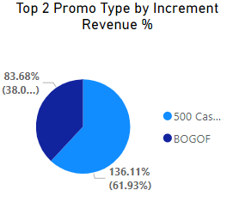
PROMOTION TYPE ANALYSIS
WHAT ARE THE TOP 2 PROMOTION TYPES THAT RESULTED IN THE HIGHEST INCREMENTAL REVENUE %?
-In analyzing the promotional strategies that contributed significantly to incremental revenue %, two types emerged as the top performers: the $500 cashback promotion and the BOGOF (Buy One, Get One Free) promotion.
-The 500 cashback promotion garnered an impressive share of 136.11 million, accounting for 61.93% of the total incremental revenue %. This promotion type effectively incentivized purchases, driving substantial revenue growth within the specified timeframe.
-Similarly, the BOGOF promotion type demonstrated its effectiveness by capturing a significant share of 83.68 million, representing 38.0% of the total incremental revenue %.
-To visually represent the distribution of incremental revenue % attributed to these top-performing promotion types, a pie chart provides a clear and concise overview. In the pie chart, the 500 cashback promotion segment occupies the majority share, followed by the BOGOF promotion segment.

Slide 21
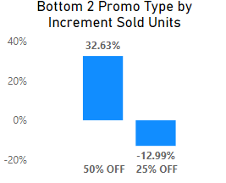
WHAT ARE THE BOTTOM 2 PROMOTION TYPES IN TERMS OF THEIR IMPACT ON INCREMENTAL SOLD UNITS %?
-Based on the analysis of Incremental Sold Units (ISUs) % resulting from different promotion types, it's evident that the 50% discount promotion had a significantly positive impact, leading to an increase of 32.63% units sold compared to the baseline. Conversely, the 25% discount promotion showed a decrease of -12.99% Incremental Sold Units.
-This indicates that the 50% discount promotion was more effective in driving sales and attracting customers compared to the 25% discount promotion. Therefore, in terms of Incremental Sold Units %, the 50% discount promotion outperformed the 25% discount promotion.

Slide 22
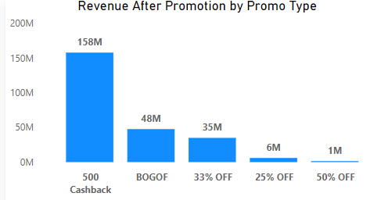
WHAT ARE THE KEY INSIGHTS GAINED FROM ANALYZING THE REVENUE AFTER PROMOTION GENERATED BY DIFFERENT PROMOTIONAL TYPES?
-500 CASHBACK: THIS PROMOTION GENERATED THE HIGHEST INCREMENTAL REVENUE, INDICATING ITS EFFECTIVENESS IN DRIVING SALES.
-BOGOF: While BOGOF resulted in significant revenue, it was slightly lower compared to the 500 Cashback offer.
-33% Discount: This discount contributed moderately to revenue after promotion.
-50% Discount: Although the discount percentage was higher, the revenue after promotion generated was relatively low.
-25% Discount: Surprisingly, this promotion resulted in 1M revenue after promotion, suggesting it may not have been well-received by customers or may have impacted profitability.

Slide 23

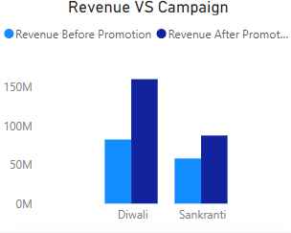
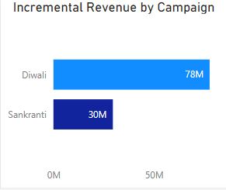
PRODUCT AND CATEGORY ANALYSIS
CAN YOU PROVIDE INSIGHTS INTO THE INCREMENTAL REVENUE GENERATED BY THE DIWALI AND MAKAR SANKRANTI CAMPAIGNS?
-In our recent analysis, we delved into the incremental revenue generated by our Diwali and Makar Sankranti campaigns, two crucial periods for our business.
-Our data reveals that our Diwali campaign resulted in a revenue increase of 78 million, while the Makar Sankranti campaign generated an additional 30 million in revenue.
-Both campaigns demonstrated the effectiveness of our marketing strategies during festive seasons, showcasing our ability to capitalize on consumer trends and preferences.

Slide 24




STRENGTH
City
Campaign
Promotion Type
Bengaluru is witnessing the highest incremental revenue among the analyzed locations.
The Diwali campaign is proving to be more effective than the Sankranti campaign
The 500 cashback and Buy One Get One Free (BOGOF) promotion types are showing significant success.

Slide 25



WEAKNESS
City
Product Type
Promotion Type
Increased focus is required for marketing and operational strategies in Vijayawada and Trivandrum to enhance performance and capture market potential.
There is a need to concentrate efforts on personal care items.
The 25% off promotion is performing poorly and facing significant challenges

Slide 26



SUGGESTION
Expanding the footprint of our stores and introducing supplementary promotional incentives are pivotal actions aimed at fortifying our market presence and enhancing performance in both Vijayawada and Trivandrum.
The promotion offering a 25% discount is experiencing lackluster performance and encountering considerable obstacles.
To enhance sales in the personal care category, it is advised to introduce Buy One Get One Free (BOGOF) promotions and place significant emphasis on marketing these offers effectively.
Introducing targeted discount vouchers tailored exclusively for home appliance purchases.
The current performance of the STECHE1 store is below expectations, necessitating a shift in strategy. It's crucial to pivot towards enhancing sales by emphasizing the promotion of personal care items. This strategic redirection will be instrumental in boosting both sales figures and overall performance.

Slide 27






ATLIQ
MART
Thanks For Watching
Connect with me.
harshit.arora1515@gmail.com
https://codebasics.io/portfolio/Harshit-arora
www.linkedin.com/in/harshit-arora15/
https://github.com/harshit9711

